Slide 1
Temperature
This material is provided by the FunThink team, responsible institution:
Ludwigsburg University of Education
Unless otherwise noted, this work and its contents are licensed under a Creative Commons License (CC BY-SA 4.0). Excluded are funding logos and CC icons / module icons.

Slide 2
Temperature

Slide 3
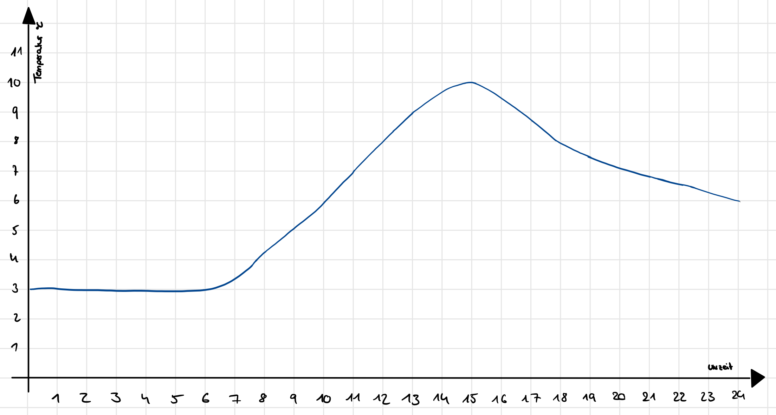
Temperature Stuttgart
temperature (°C)
time
Source temperature data: https://www.wetter2.com/europe/germany/baden-wurttemberg/stuttgart?page=past-weather#day=2&month=2 (25.03.2022)

Slide 4
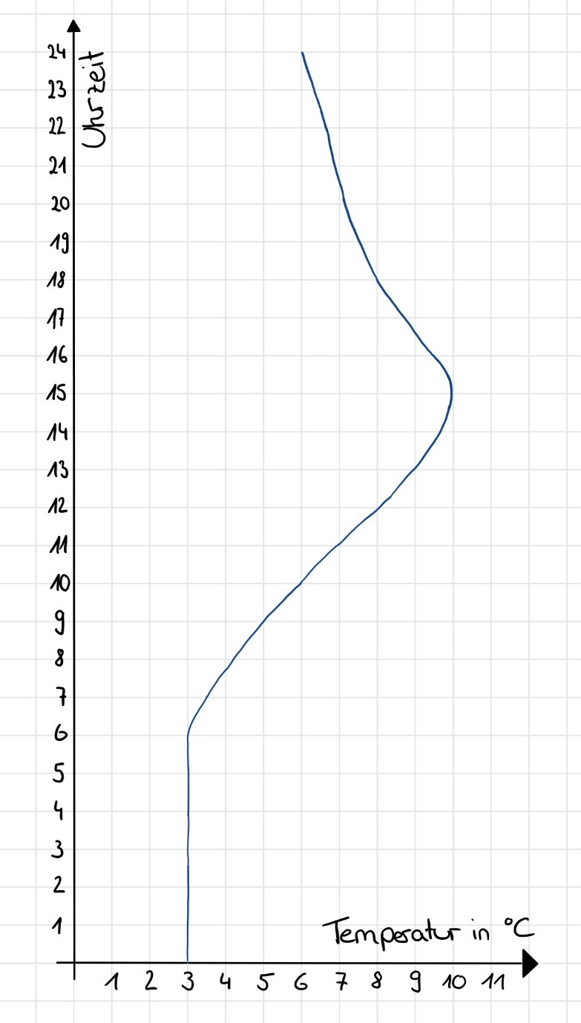
time
temperature (°C)

Slide 5
time
temperature (°C)
time
temperature (°C)

Slide 6
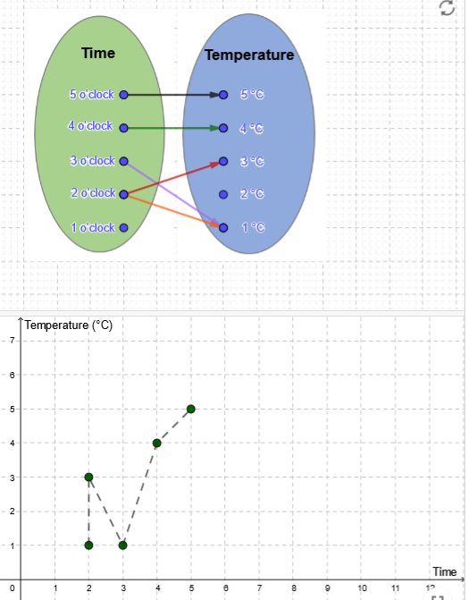
GeoGebra „Temperature“
Complete the research assignment in GeoGebra.
move arrows

Slide 7
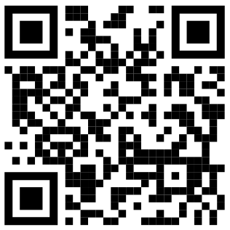
Task:
Scan QR code. This leads you to the GeoGebra applet „Temperature“.
Complete the research assignments in order and record your findings in your research booklet.
https://www.geogebra.org/m/uka5kz4c

Slide 8
Function as unique mapping

Slide 9
Function as unique mapping

Slide 10
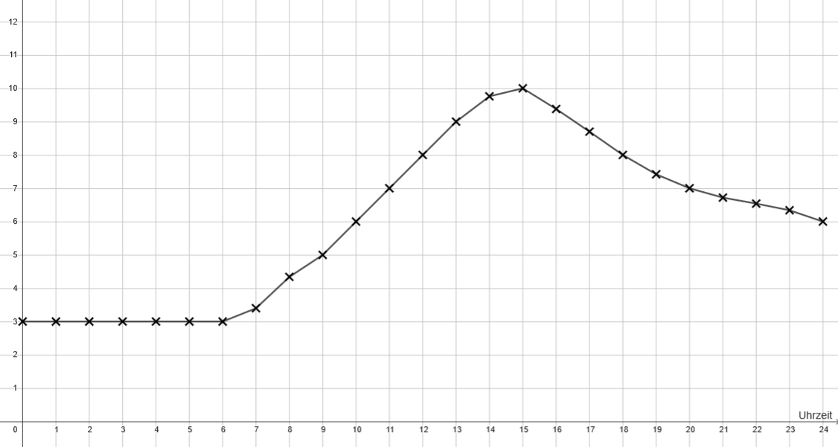
Which graph fits better?
Temperature (°C)
Temperature (°C)
time
time
A B
Notes:
Description of graph
Simplified graph
Discussion of linearity in graph B
Conclusion: Graph A fits better, temperatures don’t change in a linear way

Slide 11
Which graph is a function?
time
temperature (°C)
time
temperature (°C)

Slide 12
Is this mapping unique? Explain!
1 2 3

Slide 13
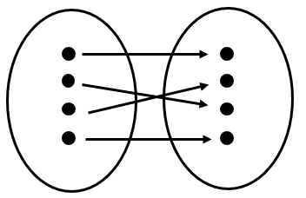
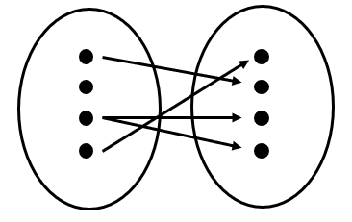
Is this mapping unique? Explain!
1 2

Slide 14
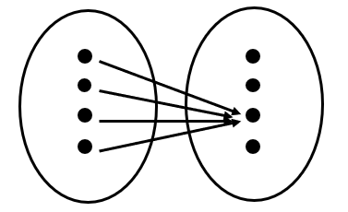
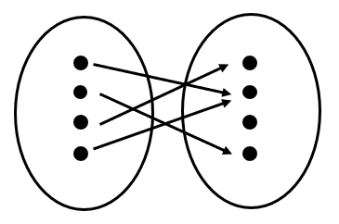
Is this mapping unique? Explain!
1 2

Slide 15
Is this mapping unique? Explain!
Situation 1: The number of cucumbers and their price.
Situation 2: The burning time of a candle and the height of a candle.
Situation 3: The distance traveled to school and the time taken.
Situation 4: An English word and its translation into another language.

